Slide 1
How to register and become prequalified with Grant Accountability and Transparency Act

Slide 2
First Stop Business Information Center
DCEO offers a single statewide resource for entrepreneurs and businesses to obtain comprehensive regulatory and permitting information. Center staff provide professional guidance to entrepreneurs by linking them to state and local resources. Services include:
•Toll free helpline 1.800.252.2923 or email us
•Para información en español por favor llamar al: 1.800.252.2923 o envíe su mensaje por medio del Correo electrónico Sonia.Gerson@illinois.gov
•Business startup kit & business specialists
•Starting Your Business In Illinois Handbook (PDF English / Spanish)

Slide 3
THINGS YOU NEED TO REGISTER WITH GATA
DUNS
FEIN
Illinois Secretary of State (SOS) registration (if required)
SAM.GOV registration completed
The information here needs to match what is in the State’s system
You will be issued a CAGE code once this registration has been completed
Organization contact information
Fiscal year-end

Slide 4
To register in SAM.gov go to https://sam.gov/SAM/

Slide 5
Complete the steps to create a SAM.gov account

Slide 6
Once you have created a SAM.gov account, log in and register your entity.

Slide 7
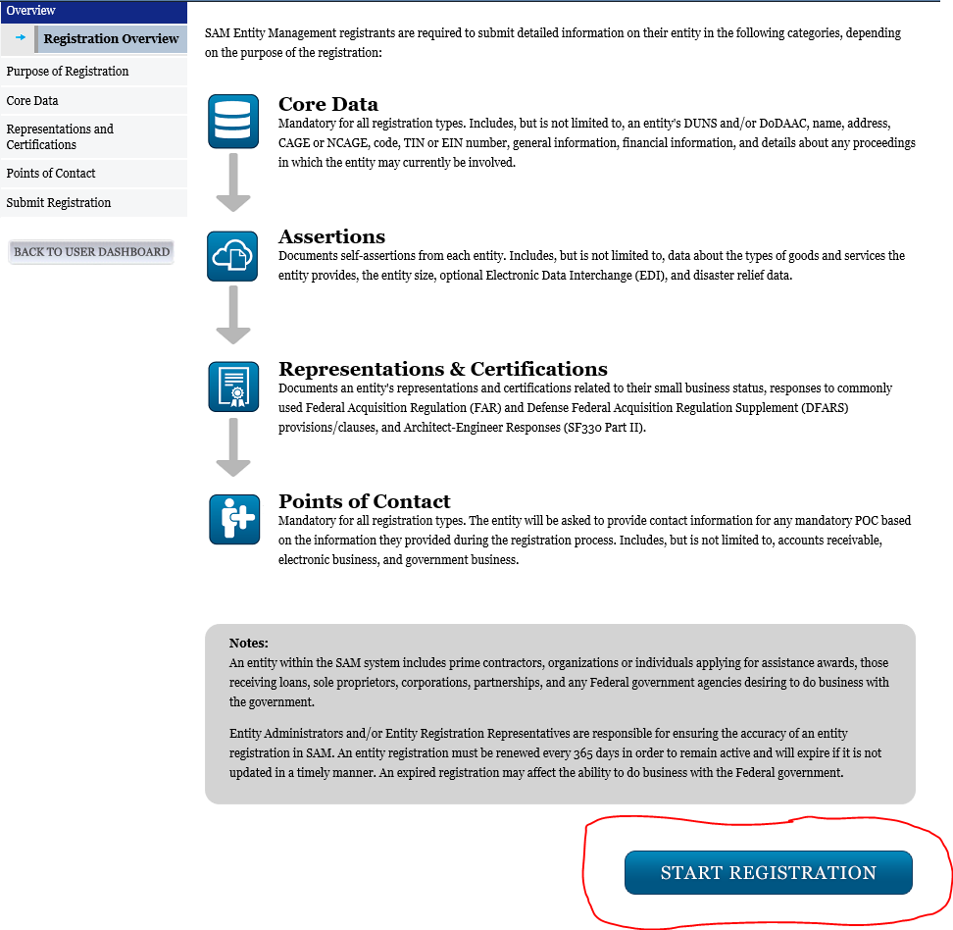
You will need to complete each section of the registration. Click “Start Registration” to begin the process.

Slide 8
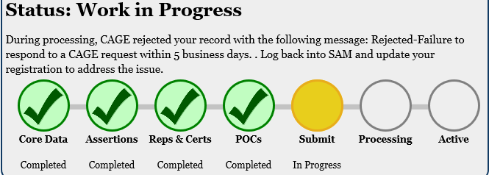
Obtaining an active SAM.gov account can take several weeks depending on the volume of requests to SAM.gov. If you have any questions about the process, SAM.gov offers a customer service line 866-606-8220 or a live chat option at https://www.fsd.gov/.

Slide 9
There are five grantee pre-award requirements are mandated by Federal Uniform Guidance (2 CFR 200) and the Grant Accountability and Transparency Act (GATA). Grantees must complete these requirements prior to receiving a grant award from the State of Illinois (Steps 1-3 must be completed prior to submitting a grant application):
GATA Portal Steps
1. Authentication
2. Grantee Registration
3. Grantee Pre-qualification
4. Fiscal and Administrative Risk Assessment (ICQ)
5. Programmatic Risk Assessment

Slide 10
1. AUTHENTICATION
The Grantee Portal utilizes the Authentication Portal https://grants.Illinois.gov/portal. A personal or business email address is required to establish an account. Authentication verifies the relationship between an individual and the organization they represent. Authentication is performed once for each individual associated with a registration. To obtain an account click the “Create account” button. For help with the Illinois.gov Authentication Portal please click the 'Can't access your account' link below the sign in button.
See next 2 slides

Slide 11
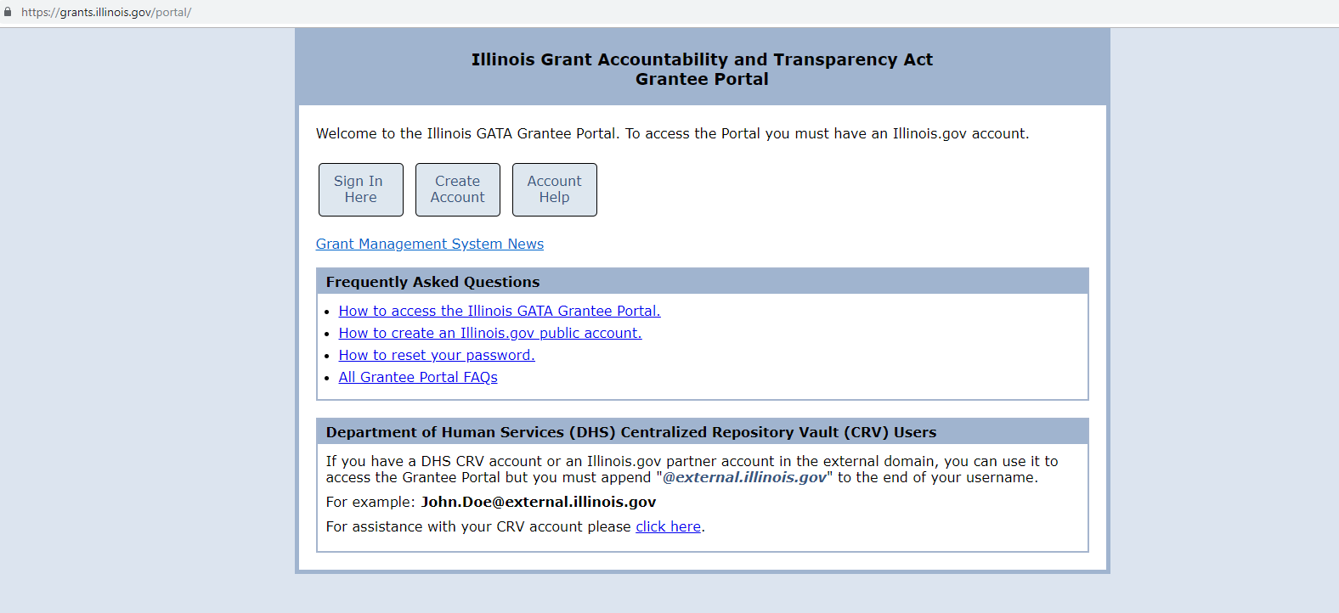
https://grants.Illinois.gov/portal Be sure to use Internet Explorer as your web browser.

Slide 12
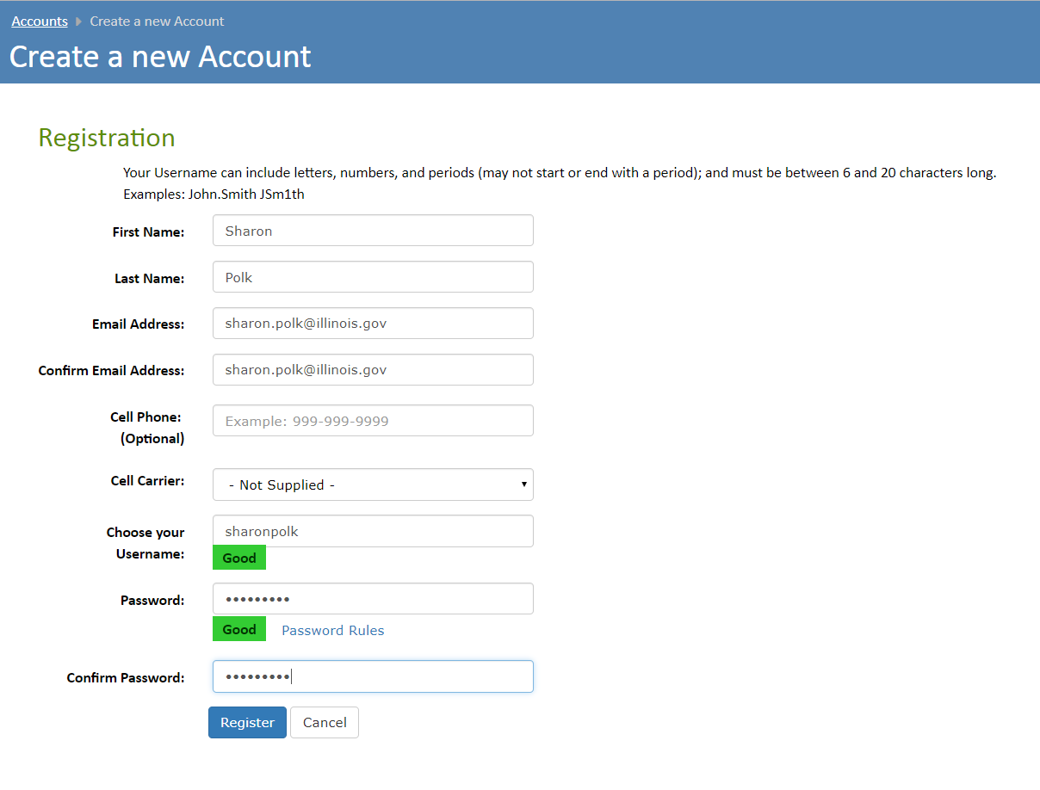

Slide 13
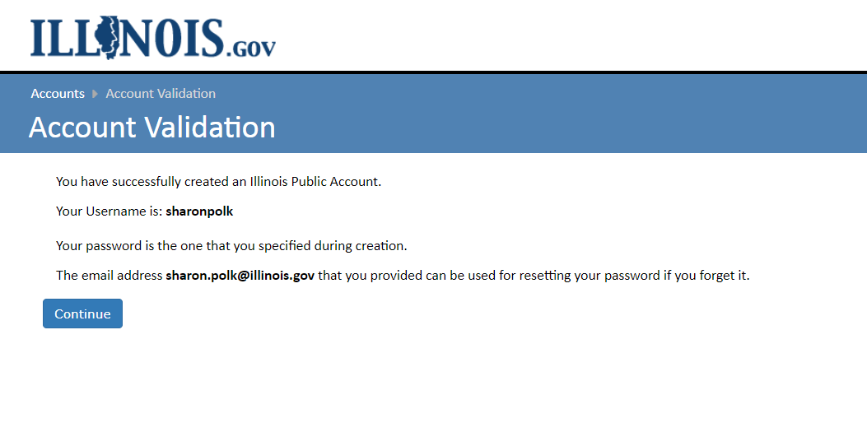
You should receive an email from IdentityManagement@Illinois.gov to the address you entered to create your new account. If you did not receive the email, check your spam or trash folder. To verify your account you will need click the link in the email message that was sent from IdentityManagement@Illinois.gov.

Slide 14
2. GRANTEE REGISTRATION
All grantees must be registered with the State of Illinois. Grantee Registration is completed by browsing to https://grants.illinois.gov/portal and associating your Illinois.gov account with your organization. New accounts must enter the organization’s information on the Registration screen. Existing accounts must click the “Edit” button next to the organization name on the Main Menu.
See 4 following slides

Slide 15
Go to the grantee portal at https://grants.illinois.gov/portal. Be sure to use Internet Explorer as your web browser.

Slide 16
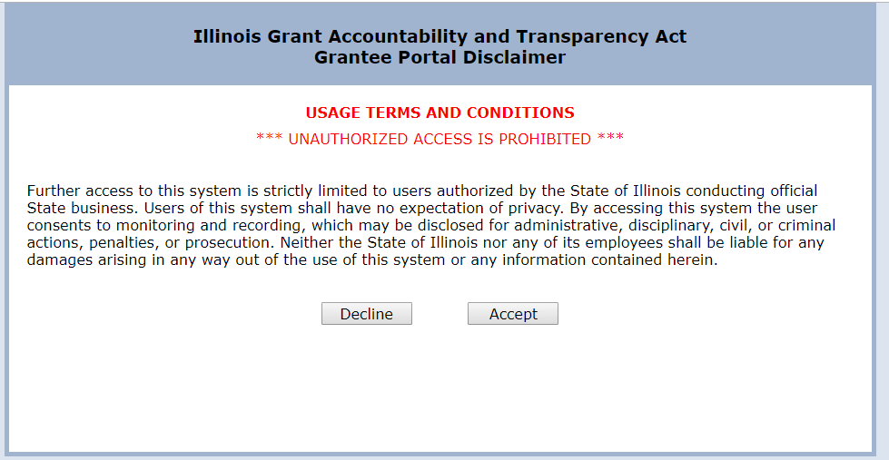

Slide 17
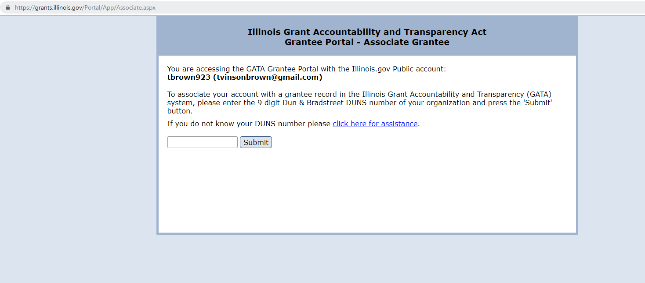
To begin creating your GATA account, enter the DUNS number.

Slide 18
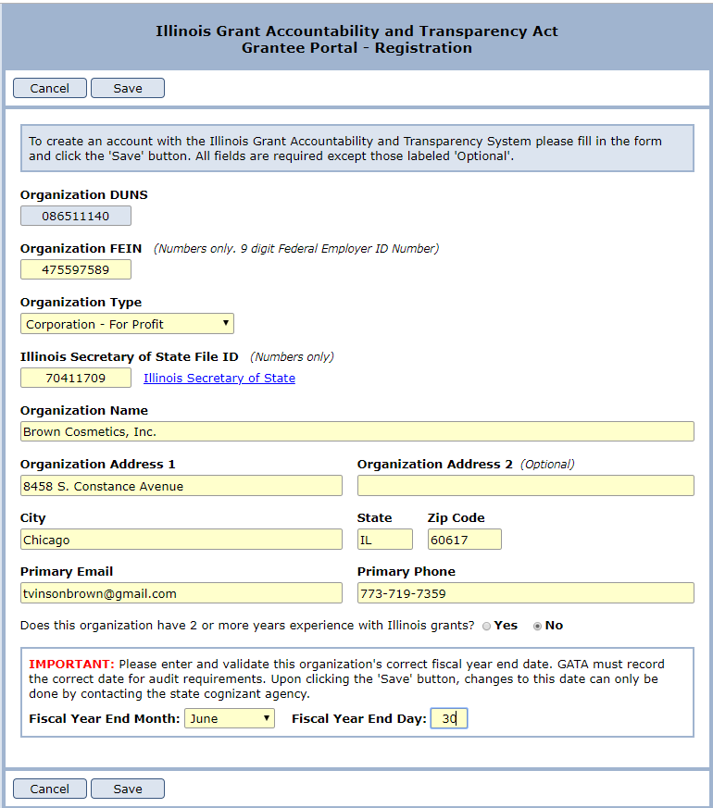

Slide 19
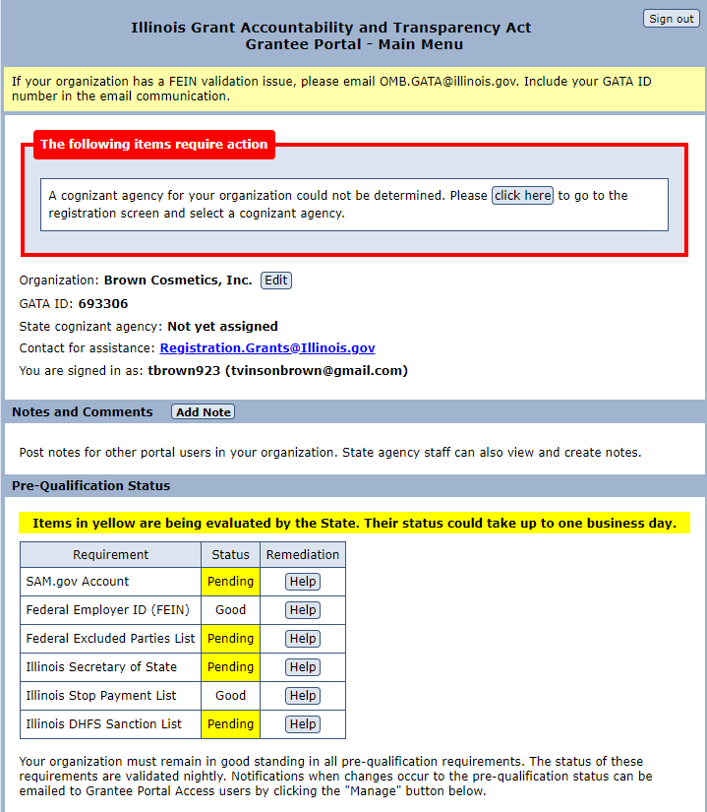
3. GRANTEE PRE-QUALIFICATION
All entities must be qualified to do business with the State of Illinois. To be qualified for a grant award, an entity must:
Have a valid DUNS number;
Have a current SAM.gov account;
Not be on the Federal Excluded Parties List;
Be in Good Standing with the Illinois Secretary of State, as applicable;
Not be on the Illinois Stop Payment list;
Not on the Dept. of Healthcare and Family Services Provider Sanctions list.
Pre-qualification status will be verified after Grantee Registration is registered and nightly thereafter. If an entity has a pre-qualification issue, the specific issue and remediation support is provided thru the grantee portal. Entities on the Federal Excluded Parties List are not eligible to do business with the State of Illinois.

Slide 20
4. FISCAL AND ADMINISTRATIVE RISK ASSESSMENT (ICQ)
Entities must complete an Internal Controls Questionnaire (ICQ) as the Fiscal and Administrative Risk Assessment.
The ICQ is completed once annually. All state agencies will utilize the results of the ICQ.
The entity can access the ICQ from the grantee portal.
See next 8 slides

Slide 21
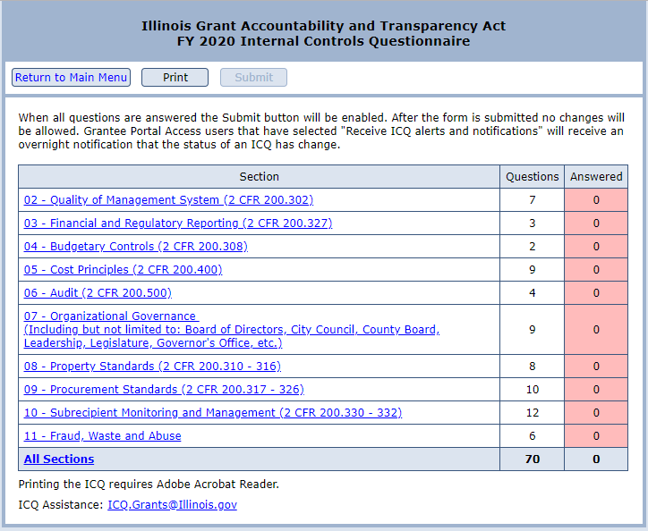
The ICQ contains 10 Sections of questions that a grantee must complete.

Slide 22
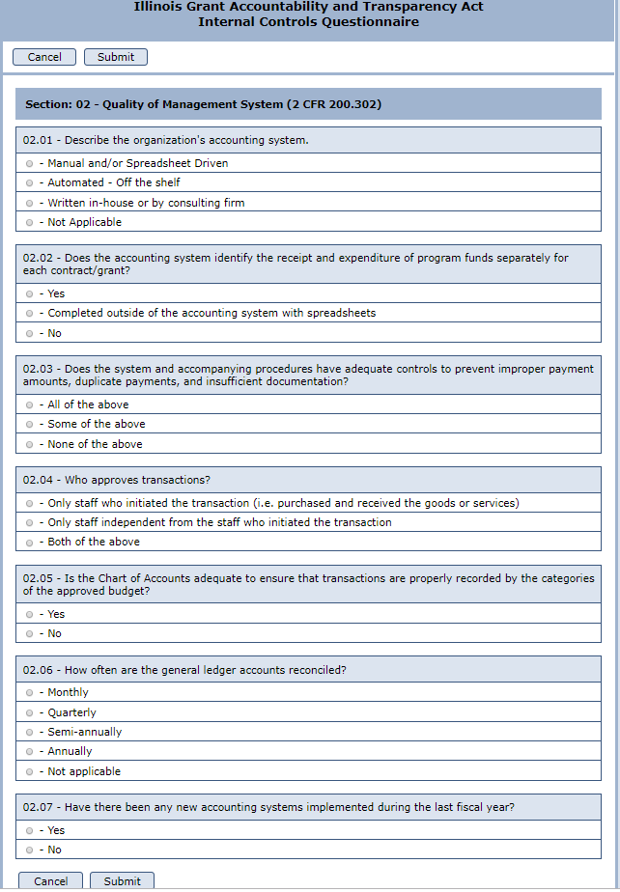

Slide 23
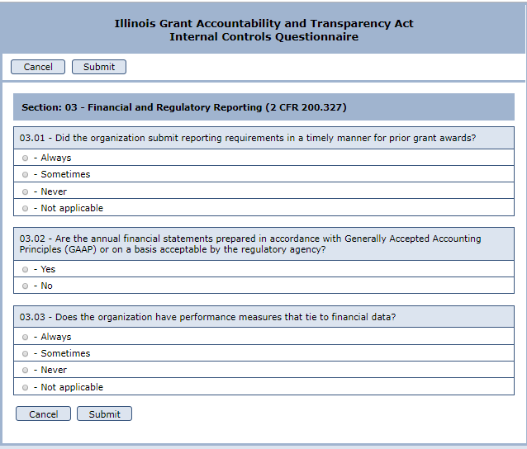

Slide 24
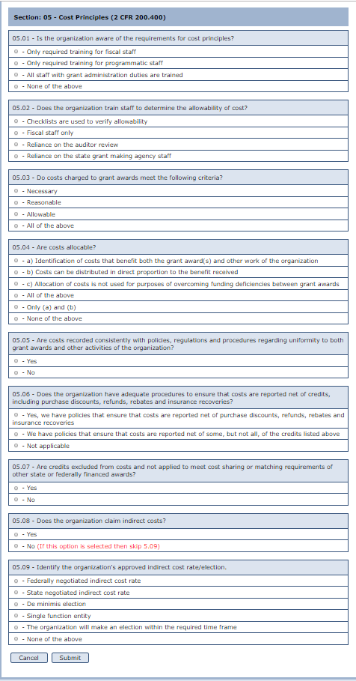
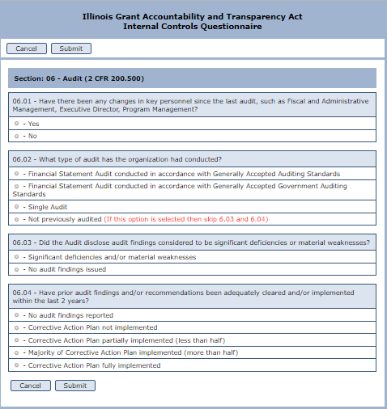

Slide 25
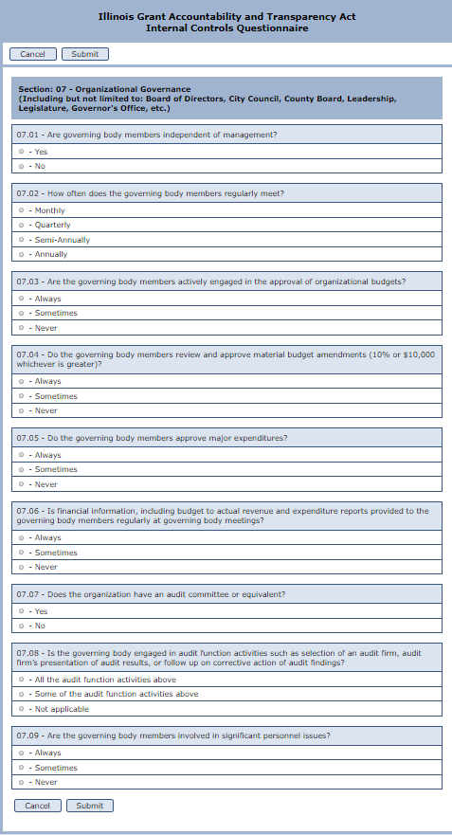
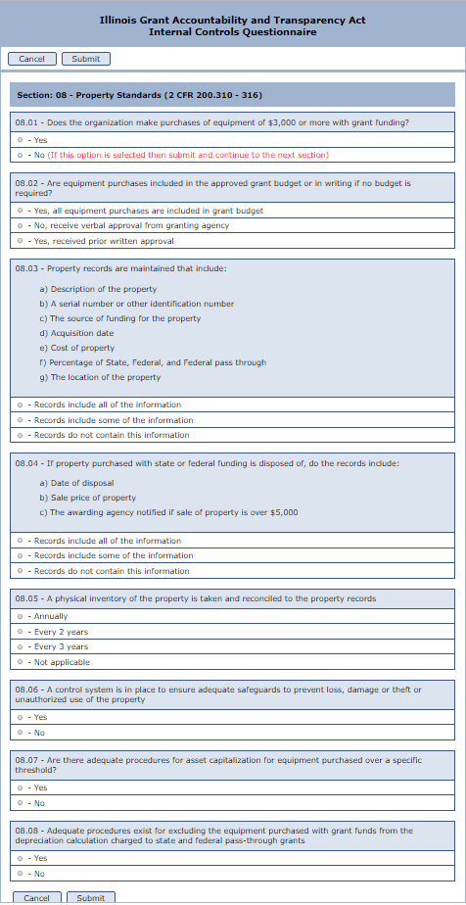

Slide 26
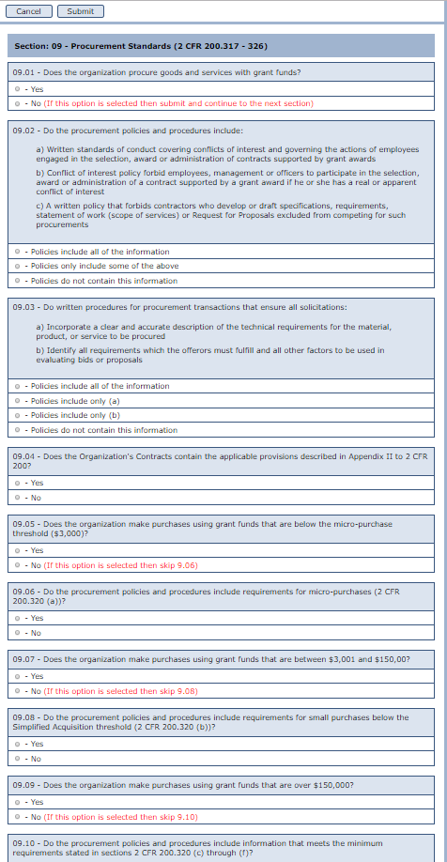
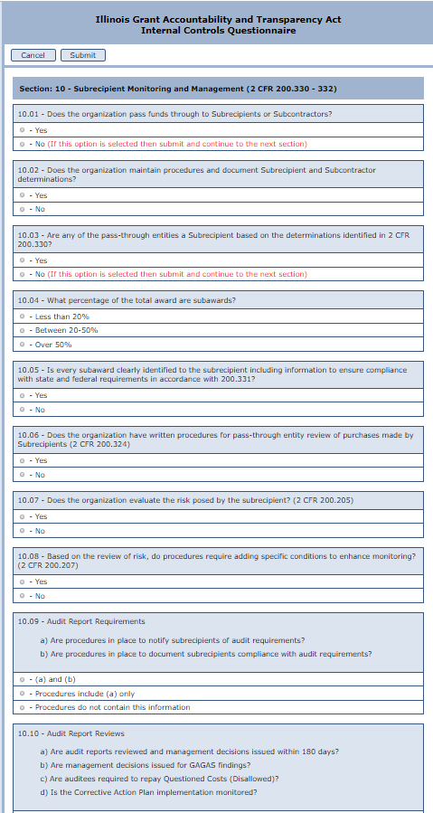

Slide 27
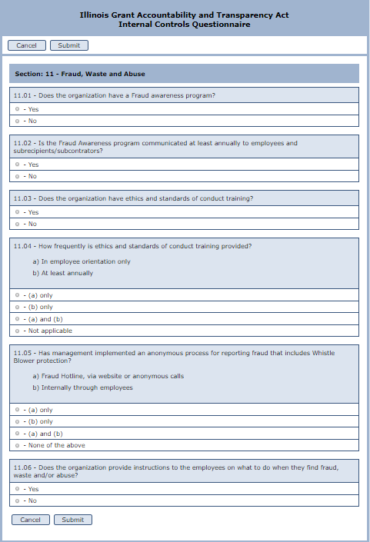

Slide 28
When all of the questions are complete, the submit button will become red.
Enter the names of the entity CEO, CFO and the person completing the assessment and click certify and submit.

Slide 29
5. PROGRAMMATIC RISK ASSESSMENT
Entities must complete a Programmatic Risk Assessment for each grant award. The grant-specific Programmatic Risk Assessment is administered by the awarding agency.
The programmatic risk assessment is generally performed towards the end of the application process. Your state awarding agency will inform you of the timing of the Programmatic Risk Assessment and administer the Programmatic Risk Assessment.
These grantee pre-award requirements are mandated by Federal Uniform Guidance (2 CFR 200) and the Grant Accountability and Transparency Act (GATA). Grantees must complete these requirements prior to receiving a grant award from the State of Illinois. Questions regarding the grantee pre-award requirements should be directed to your state awarding agency.

Slide 30
Questions?
If you have questions concerning the GATA process, you may contact your grant manager or email CEO.GATA@Illinois.gov

